Slide 1

COMPANY PROFILE
Propriety & Confidential

Slide 2

ABOUT US
PTech Pvt. Ltd is a growing sub vendor company in the telecom and IT Sector. PTECH has presence across India and with multi-domain experts. The company has created a name for itself as a reliable partner for delivering and implementing solutions by providing RF Services,System Integration Services, Network Design and Implementation Services, Network/Telco Automation Solutions,EMF and Broadband Surveys, end-to-end consulting and specialized manpower supply to the telecom/IT companies. We believe in providing best services in the industry at optimum prices by innovative Products & Solution offerings and spreading knowledge among team.
PTech is the leading Network Planning and Optimization Company. The company provides network planning, optimization services, BTS installations and operations support for fixed and Wireless operations, RF services & in building solutions to Wireless providers. Beyond these services, it has expanded to cover Turnkey solutions, RF Planning and Optimization, Network Performance Services and IP Planning. It undertakes task based projects requiring delivery of tangible results in the form of either cell site production or network quality improvement and has consistently met or exceeded Key Performance Indicators (KPI).
PTECH’s business model reflects our spirit of flexibility in the Telecom solutions domain and allows our clients to choose the model that best suits their requirements.
ABOUT INDUSTRY
The IT/Telco industry has undergone explosive growth and has become global in its scope and ambitions. Spectrum has become severely congested. Good network design is no longer a “nicety”, but rather a necessity. Competitiveness in Telecommunications Industry is looking for simpler, cost effective and innovative strategies. Wireless services and Products are essential requirements.
Propriety & Confidential

Slide 3

VISION
We at PTech offer extensive services in the telecom sector and are equipped to respond to the industrial changes with a fine blend of industry knowledge, targeted services, technology and functional expertise with a proven delivery model. By leveraging the onsite-offshore virtual model in the telecom solution space as well, P Tech ensures our client receives “to the specification, on time, within budget” delivery. Our comprehensive Telecom solutions portfolio enables in taking advantage of the changing trends in the Telecom industry.
MISION
To Become One Stop Telco/IT Solution provider, with the commitment to deliver End-to-End, Accurate, Quality Solutions at Cost Effective Terms to our esteemed clients. Our goal is to become a leading network planning and optimizing company. Our dedicated and capable engineers ensure that all the projects are driven by challenging performance benchmarks and our final deliverables result in quantifiable improvement in the network quality and performance.
VALUES
We aim for total customer satisfaction and seek to achieve conformity by carrying out quality awareness activities at all stages of development
Continuous Innovation, Transparency, Integrity, Customer Centric, Respect for People
Our philosophy goes beyond meeting client requirements. We meet your needs by putting ourselves in your shoes and thinking of unforeseen situations that you may come across.
Propriety & Confidential

Slide 4











WHY PTECH
OUR CLIENTS
Domain Expertise
Innovation
Productivity
Intelligence
Customer Experience
OUR APPROACH
OUR GOAL
Our goal is to become a leading network planning and optimizing company. Our dedicated and capable engineers ensure that all the projects are driven by challenging performance benchmarks and our final deliverables result in quantifiable improvement in the network quality and performance.
Propriety & Confidential

Slide 5
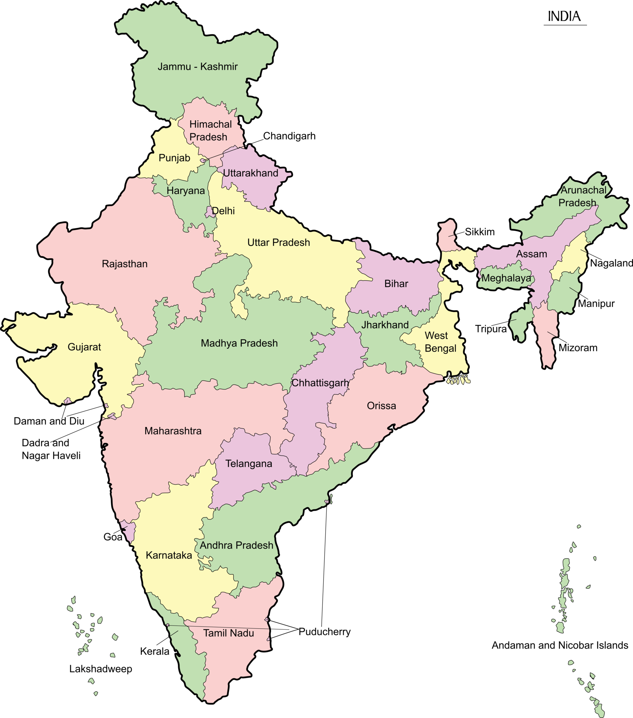
OUR PRESENCE
State | Employee Count
Orissa | 22
West Bengal | 11
Bihar | 10
AP | 11
Jharkhand | 04
Delhi/NCR | 13
Tamil Nadu | 12
Maharashtra | 10
Karnataka | 10
Gujarat | 09
Rajasthan | 07
Punjab | 05
Total Employees | 124
* Resources can be arranged anywhere in
India within 48 hours.
I & C (Router, Switch, BTS, Antenna, Power Plant, BB, OTN, DWDM, DC & Servers Etc.) | Network Design & Implementation (IP/MPLS,RF) | RF Optimization & Drive Test | Preventive Maintenance & Check List | Network/Telco Automation | Data Center Design/ Operations
Propriety & Confidential

Slide 6


ACHIEVEMENTS
ASSIGNMENTS | CLIENT NAME | LOCATION
Cisco & Nokia Router Installation, Integration & Migration | VODAFONE IDEA NOKIA BSNL AIRTEL | Pan India
Antenna Installations, BTS Installations, RF Optimizing and Drive Test | NOKIA ERICSSION | Pan India
New TDD Site Installation, Integration & RF Optimizing | VODAFONE IDEA | Pan India
Microwave Dismantling, Installation & Integration Of Equipment Huawei, Nokia, NEC, Ceragon etc. | TATA COMMUNICATION | Pan India
Preventive Maintenance & Check List | TATA COMMUNICATION | Pan India
“A Little Progress Each Day Adds Up To Big Results”
Propriety & Confidential

Slide 7


SERVICES WE OFFER
We believe quality is not just another goal, it is our basic strategy for continuous growth. Our strong commitment towards process excellence has resulted in enhanced productivity and reduced project execution cost.
PTECH
Network Design & Implementation
RF Planning & Designing
RF Optimization & Drive Test
Network Support/Operations Services
Transmission Planning Services
Resource Management
Automation
Solutions
Data Center Design & Solutions
Product Offerings
ONE STOP PLATFORM FOR NETWORK PLANNING,DESIGN AND OPTIMIZATION
“QUALITY FIRST”
Propriety & Confidential

Slide 8


SERVICES WE OFFER
Network Design & Implementation
Operator facing challenges are extensive and unavoidable. New technology, Coverage, Capacity, and Maximizing the Value of Existing Network Resources, are challenging requirements. Network Planning is crucial services for designing any network. ETPL helps customer not only in Network design but also in expanding rapidly and cost effectively.
As part of the network planning We offer the customers following services:
Network Design and Dimensioning (IP/MPLS,RF)
Access Network Planning
Transmission and Synchronization plan
Switching Network Topology
Techno-commercial Bid preparations
BOQ Recommendations and Validations
Technology can never be static, We learn, we adapt and we are the best at it.
Propriety & Confidential

Slide 9


SERVICES WE OFFER
RF Planning & Designing
PTech’s resources are well trained to use state-of-the-art industry standard tools for design, planning and testing the networks to ensure that the network design meets the network performance objectives of the customer.
As part of the RF Planning & Designing We offer the customers following services:
RF Cell Planning
Initial dimensioning of the radio network
CW Propagation model tuning
Candidate identification & nominal planning
Technical site surveys » Frequency Planning
Static frequency allocation
Frequency hopping (RF hopping or Baseband hopping)
Frequency and neighbors planning
Hierarchical Cell structure
Capacity Planning
Coverage and capacity planning and analysis
Addition of new cell sites
Upgrade of existing cell sites
Signaling/SDCCH dimensioning
Additional spectrum use
Traffic Management
Propriety & Confidential

Slide 10

SERVICES WE OFFER
RF Optimization & Drive Test
High quality of service in mobile networks is the prerequisite for the commercial success. Continuous optimization is a process, which focuses on checking the network quality continuously and takes actions when needed. It is a more constant way of maintaining good quality in the network, especially when the mobile networks are changing rapidly and more and more customers are being served.
As part of the RF Optimization, We offer the customers following services:
Parameter Configuration Check (OMC Audit)
Traffic and throughput analysis
Parameter planning and optimization
Dropped call analysis
Handover success analysis
Drive Test analysis
Interference analysis
Field measurements and acceptance testing
Frequency & Strategy Planning
Propriety & Confidential

Slide 11


SERVICES WE OFFER
Network Operations Services
Network performance is a measure of how effectively and efficiently the network is functioning. Network performance is an internal measure mainly derived from Network Management data. This measure provides an Engineering perspective of network quality.
As part of the Network Operations Services, We offer the customers following services:
Provide Subscriber perception of service
Benchmark figures against competitors
QoS reports for Senior Management
Analysis and evaluation of network upgrades
Acceptance testing of new networks / new regional rollouts.
Independent benchmarking of vendor equipment's.
Continuous/repetitive monitoring to highlight slow degradation of Network Quality Provision of Engineering data for further analysis
Network Auditing and Remediation Services
Network Monitoring and Surveillance Solutions/Services
Automated Incident Management Solutions/Services
Propriety & Confidential

Slide 12

SERVICES WE OFFER
Transmission Planning Services
Transmission network planning covers definition of the whole network topology, technology selections, equipment configurations, synchronization and management plans. Essential areas of expertise are also site candidate identification and selection, technical site surveys and line-of-sight checks is a more constant way of maintaining good quality in the network, especially when the mobile networks are changing rapidly and more and more customers are being served.
As part of the Transmission Planning Services, We offer the customers following services:
Initial dimensioning of the transmission network
Transmission media selections: microwave (PDH), SDH, optic, copper, leased line, Satellite Existing network evaluation/ expansion
Technical site surveys
Line-of-sight surveys
Capacity and topology planning
Synchronisation planning
Network management planning
Routing with time slot allocation
MW link level planning and interference analysis
BSC/RAN area boundaries definition
Propriety & Confidential

Slide 13

SERVICES WE OFFER
Resource Management
Having the best talent is a competitive advantage in today’s demanding and complex world The success of any business relies upon talent; acquiring the most qualified people is increasingly competitive.
PTECH provides placement and deployment of resource as a service. We have a databank of qualified experts and professionals .Our HR team excels in recruitment and training, which results in retention of skilled resources.
We provide Quality Resources as:
RF Planner
RF Optimization Engineer
Transmission Planner
Drive Testers
Data Analysts
RF & LOS Survey Engineer
EMF Survey Engineer
Resident Engineers/Solution Architect
OSS/BSS Engineer
O&M Engineer (ISP/OSP)
NOC Engineer
IBS Planner
Project Managers
Automation Developers
Propriety & Confidential

Slide 14

SERVICES WE OFFER
Resource Management Cont.
Built upon our deep recruitment expertise and based on rigorous processes, our innovative approach ensures the results you need
PTech focuses on providing clients with the correct fit for their resource requirements.
We engage with the client at all levels to provide them with the exact match for their requirements within the committed time frame and budget.
We have become partners of choice for our clients who adopt telecom outsourcing as a proactive strategy
We have extensive coverage in the telecom domain with specialized support for managed services teams as well as resident engineers for telecom majors
Propriety & Confidential

Slide 15

SERVICES WE OFFER
Automation Solutions
In the era of 5G and cloud, automation is becoming essential to managing network and infra. Automation reduces human errors, the most common cause of network performance degradation and downtime, making automated networks more reliable. Service providers and large enterprises can also use automation to reduce time to market, improve customer experiences, and meet growing scalability demands with simplified network operations. The result is greater network efficiency, uptime, and consistency across the board.
As part of Automation Solutions, We offer the customers following services:
Closed Loop Automation
Auto Auditing and Remediation
Upgradation and Migration Automation
Smart Fault Management
Service Orchestration
Analytics for Network Operations
AI-Powered Network/Telco Automation
OSS/BSS Solutions and Integrations
DevOps/NetOps Solutions
CI/CD Pipelining
Propriety & Confidential

Slide 16

SERVICES WE OFFER
Data Center Design & Solutions
At PTech, we provide unified and futuristic data center innovative solutions ranging from Converged DC to Software Defined Network for DC and Network Function Virtualization. Our services also include Platform tech refresh and DC Network Migration.
Solutions
Data Center Network Design
LAN & WAN
Network Security
Identity & Access Management
Data Center Network Design
At PTech, We provide innovative and futuristic Data Centre Solutions, designed to deliver a simplified yet robust DC network, with a solution ranging from Converged DC to Software Defined Network for DC and Network Function Virtualization. Our services also include Platform tech refresh and DC Network Migration and Cloud Integrations.
Propriety & Confidential

Slide 17

SERVICES WE OFFER
Solution Offerings
2. LAN & WAN Solutions
We help to design high throughput network which provides unified and agile network for voice, video and data. Provisioning a centralized management to control heterogeneous network along with creating a backbone of intelligent and structured cabling is our objective.
Unified 2 tier campus LAN
Secured Wireless and BYOD
Dynamic Multipoint VPN
Software Defined WAN
3. Network Security
At PTech, We have highly specialized security framework, designed to protect an organization at various layers like Gateways, LAN, Endpoints, Applications and Databases. we lead the market in providing integrated next gen security like protection from APT and DDoS.
Next Gen Perimeter Security
DDoS Solution
DLP Solution
APT Solution
Security Analytics Solution
Propriety & Confidential

Slide 18
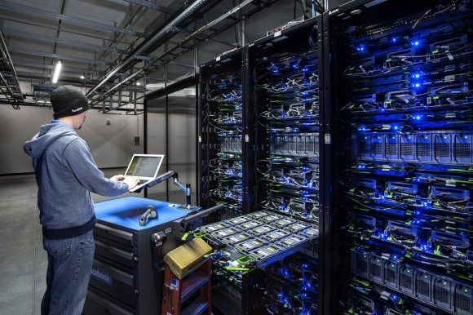
SERVICES WE OFFER
Product Offerings
Routing & Switching
Edge Router
Core Router
Core/Aggregation Switch
Access Switch
2. Wireless
WAP
Wireless Controller
NAC
3. APM/NPM
Server Load Balancer
Link Load Balancer
WAN Optimization
Network Performance Visibility
4. End Point Security
Anti Malware
End Point DLP
End Point Encryption
5. Security Analytics
Firewall Analyzer
VA/PT Software
SIEM Appliance / SW
6. Network Automation
Network Backup and Audit Platform
Network Route Analyzer
Device Upgradation Automated Platform
Propriety & Confidential

Slide 19

HEALTH & SAFETY
PTech is committed for safety at work & all employees are well trend for occupational health & Safety. OHS trainings helps in reducing losses in terms of injury, accidents & even life.
OUR ADVANTAGES
Working At Height
Using Safety Equipment's like helmets, safety belts
Electrical Safety
Electrical Safety for working on electrical equipment's
Vehicle Safety
No work in front of MW antenna
Safety From EMF Exposure
Pre Climbing checks and safety talks
Checking surrounding & structure prior to climbing
Using PPE for Electrical Work
Safety from Static charges
Follow all driving rules
Use a valid driving license
No driving on night hours without proper safety
Follow safety instruction for antenna installation
Inform to the operator in case of EMF exposure
End-to-end Network Planning & Optimization. Accurate, Quality Solutions at Cost Effective Terms
Visionary Management & Experienced Workforce
Process Oriented Outcome and System driven
Objectively designed as a productivity booster & best in class customer experience
Flexible solution, with simple & fast configuration
“At PTech we follow all Covid Protocols like masking and sanitizing”
Propriety & Confidential

Slide 20
THANK YOU
Corporate and Registered office
PADHI TECHNOLOGIES PVT.LTD.
N/3-458,IRC VILLAGE,NAYAPALLI
BHUBANESWAR,KHORDHA
PIN-751015
EMAIL- SALES@PTECHINDIA.COM/COMMERCIAL@PTECHINDIA.COM
WEBSITE- https://www.ptechindia.com/
CONTACT NO- 7328070714/8763425986
“ At PTech, We believe in evolution of unlimited
possibilities”
Propriety & Confidential

